Slide 1

Quantum Communications Group
Key Management System for a QKD Network
Weekly Report
Supervisors:
Armando Nolasco Pinto
anp@ua.pt
Diogo Matos
dftm@ua.pt

Slide 2
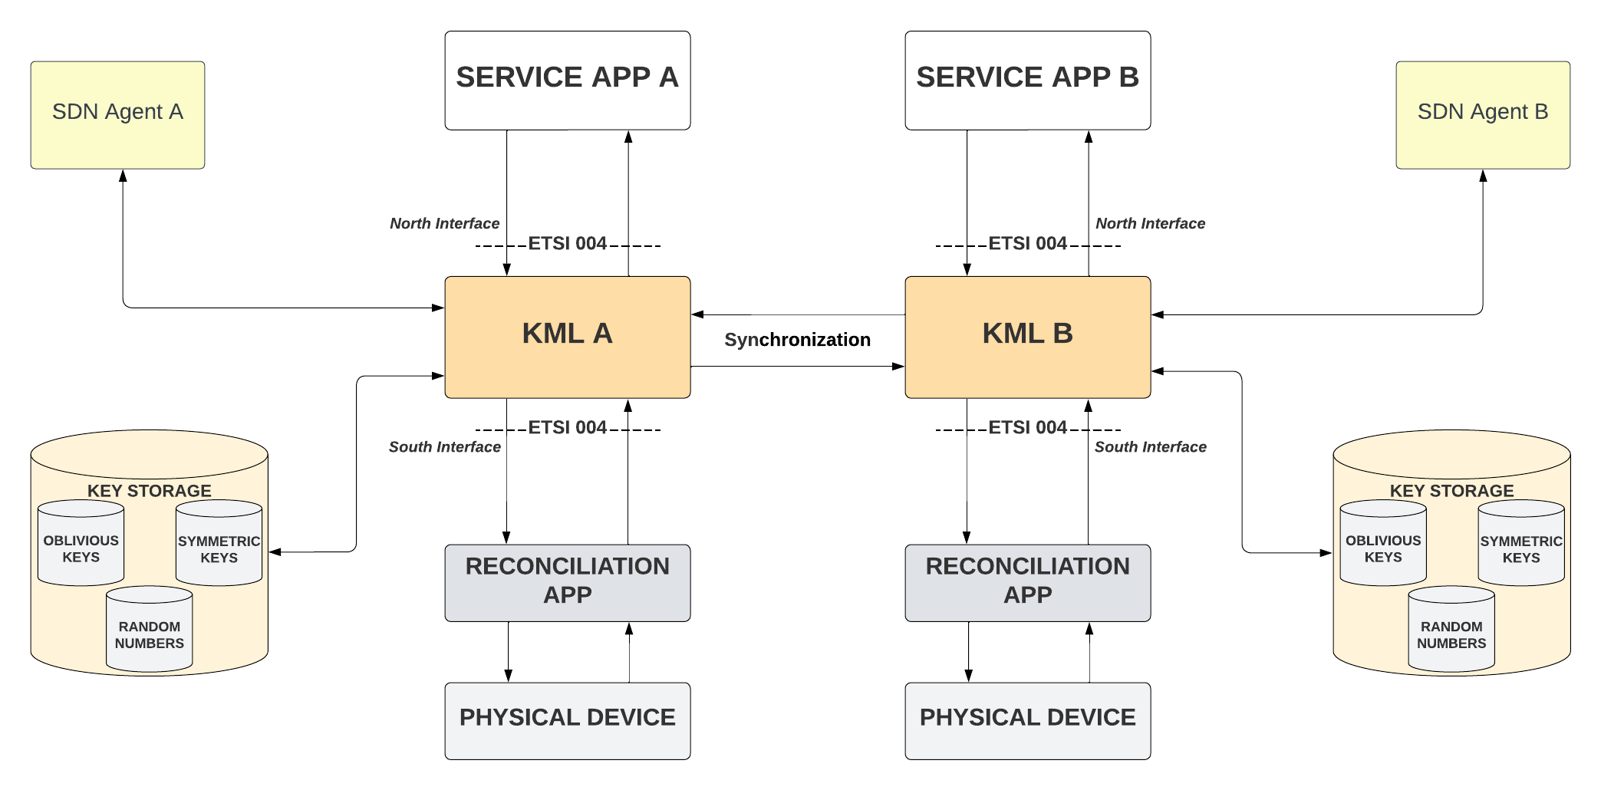
General Architecture

Slide 3
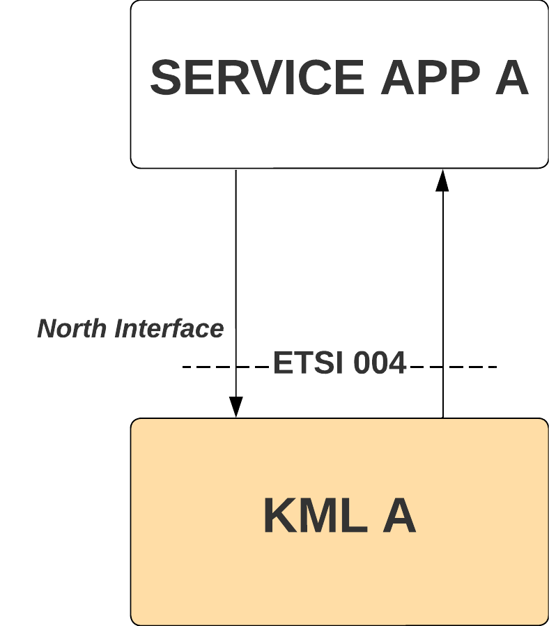
North Interface – KMS interface with the apps ETSI 004 (pull mode)
The interaction between the KMS and the app relies on three requests:
OPEN_CONNECT(in source, in destination, in QoS, inout Key_stream_ID, out status)
Is made by an app to create a key stream with the characteristics specified in the QoS field. A Key Stream id (KSID) and a status value are returned. If the OPEN_CONNECT request is made with a value in the Key_stream_ID field, it connects to an existing Key Stream instead of creating a new one.
GET_KEY(in Key_stream_ID, inout index, out Key_buffer, inout Metadata, out status)
Is used by the apps to retrieve keys. It can be made with or without an index. With a given index, the KMS will return the key, if exists, with that index. Otherwise, it returns the oldest key that was created by its peer but not retrieved yet, if there is no keys to be returned, a new one will be created and returned alongside with its index.
CLOSE(in Key_stream_ID, out status)
Is used to terminate a Key Stream connection. The peer still can retrieve already created and unexpired keys.

Slide 4
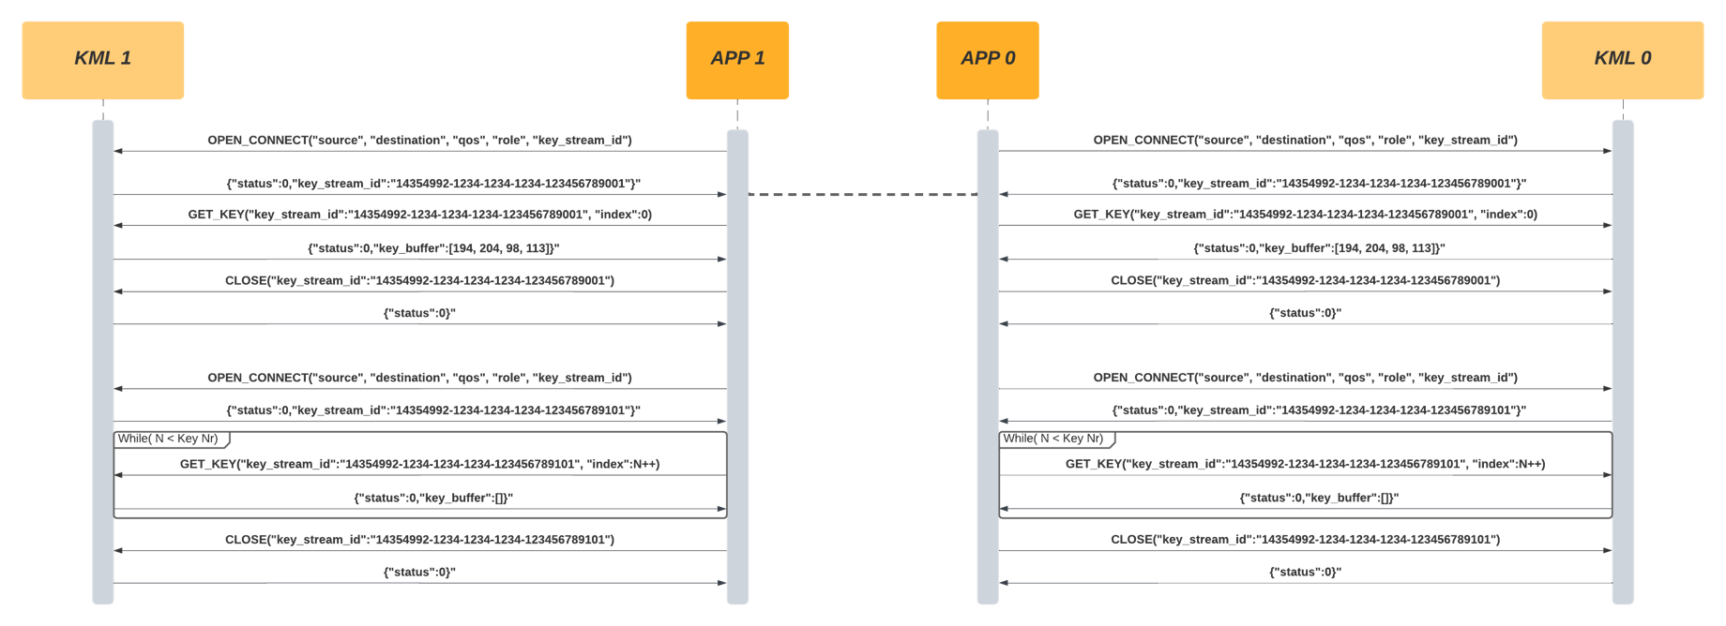
Messages Exchanged

Slide 5
QOS parameters
Key_type: key type for the key stream (not approved yet)(uint32_t).
Key_chunk_size: Length of the key buffer requested by the application (uint32_t).
Max_bps: Maximum key rate requested in bits per second (uint32_t).
Min_bps: Minimum key rate requested in bits per second (uint32_t).
Jitter: Maximum expected deviation, in bps, for key delivery (uint32_t).
Timeout: Time, in msec, after which all will be aborted, returning an error.
TTL: Time after which the keys corresponding to this Key_stream_ID shall be erased(uint32_t).
Metadata mimetype: Field that defines the format of the metadata on each subsequent GET_KEY call.

Slide 6
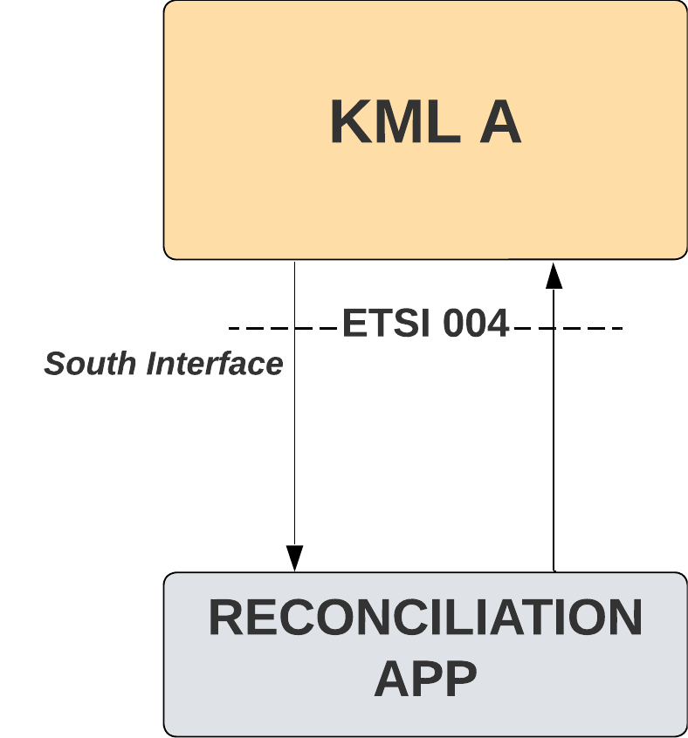
South Interface – KMS interface with the physical Layer ETSI 004 (push mode)
The KMS is always receiving keys without making individual requests for each one. The interface between the KMS and the physical layer is basically the same as the one provided by the KMS for the applications to use but now the KMS will act like an application requesting key material.
The KMS will start by making an OPEN_CONNECT request to create a connection to the physical layer. Then does one GET_KEY request and from that moment forward it will receive key material with the characteristics and pace specified in the QoS field until it makes a CLOSE request to terminate the key stream.

Slide 7
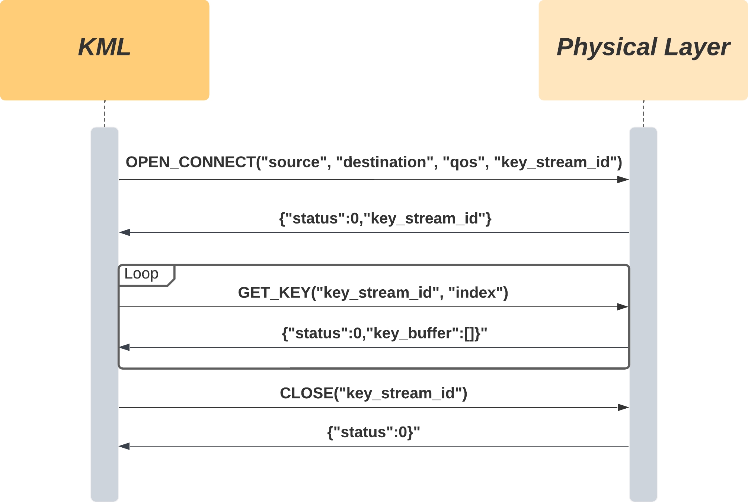
Messages Exchanged

Slide 8
QOS parameters
Key_type: key type for the key stream (not approved yet)(uint32_t).
Key_chunk_size: Length of the key buffer requested by the application (uint32_t).
Max_bps: Maximum key rate requested in bits per second (uint32_t).
Min_bps: Minimum key rate requested in bits per second (uint32_t).
Jitter: Maximum expected deviation, in bps, for key delivery (uint32_t).
Timeout: Time, in msec, after which all will be aborted, returning an error.
TTL: Time after which the keys corresponding to this Key_stream_ID shall be erased(uint32_t).
Metadata mimetype: Field that defines the format of the metadata on each subsequent GET_KEY call.

Slide 9
Key synchronization
Objective: Ensure keys across KMS systems align to provide accurate keys to applications.
Communication: Use KEY_SYNC messages to inform the peer KMSs about received keys since the last similar communication.
Protocol: The number of indexes in a message may vary, but both KMSs must agree on a consistent Key_chunk_size.
Actions on Receiving New Keys:
If an index was mentioned in a peer KMS's KEY_SYNC message and a minimum number of distinct indexes is reached, send a new KEY_SYNC message, marking received keys as synchronized (sync field at 1).
If a sent index wasn't mentioned in the peer's KEY_SYNC messages and the last notified index is higher, discard the keys.
Otherwise, store keys but mark them as unsynchronized (sync field at 0).
Updating Sync Field: Sync field of a key may later be updated based on received KEY_SYNC messages.
Discarding Not Synchronized Keys: Unsynchronized keys should be discarded after a configurable period to ensure ample time for the KMS to send KEY_SYNC messages.

Slide 10
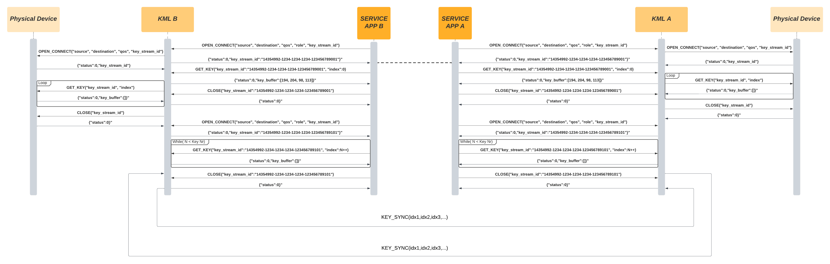
Example with QuGenome, North interface, South Interface, Synchronization Messages

